Slide 1
Executive summary templates
Use the Layout dropdown menu to select a template or build your own using these layouts as inspiration.

Slide 2
Title
Subtitle
Project Overview
Image Alt-Text Here

Slide 3
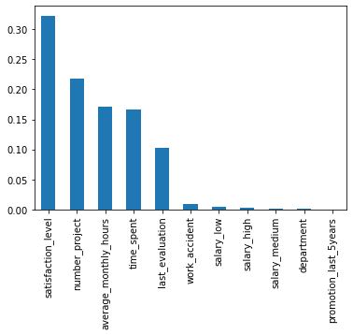
Salifort Motors Project
Predict and Prevent Employees Turnover
The employee turnover rate is high, Salifort wants to predict and prevent employees from leaving the company.
A survey was carried out by human resources to find out more about the probable reasons for employees leaving. The data collected from this survey has been analyzed with the aim of predicting employees who will leave the company.
Two different models were built to predict employees who left the company, key reasons why employees may have left were identified.
Jupyter Notebook: Feature Importance Graph
Based on the feature importance graph of the random forest model, we observed that employee satisfaction level, number of projects, average monthly hours, time spent and last evaluation were important features tied to employees turnover rate. The exploratory data analysis performed hinted that these features were indeed tied to employee turnover.
- Results of the analysis shows employees may be overworked, and dissatisfied with work or working condition. It was also observed that some employees who left had spent a good number of years with the company.

Slide 4
Title
Subtitle
Image Alt-Text Here

Slide 5
Title
Subtitle

Slide 6
Title
Subtitle
Image Alt-Text Here

Slide 7
Title
Subtitle

